Slide 1
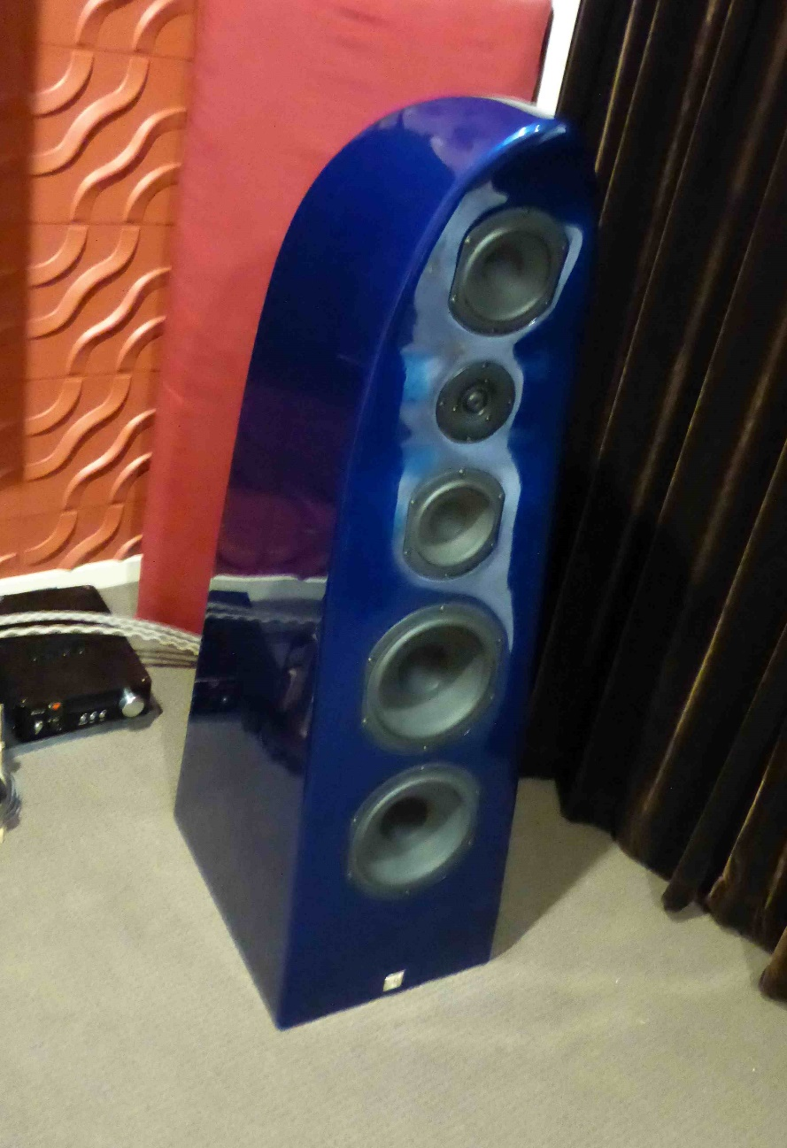
Speaker Design Course
By: Simon Ljubic

Slide 2
Considerations in choosing your design
Size of enclosure : Driver dependent (wWell mostly. Active can compensate somewhat).
Size of listening room.
Number of “ways” in speaker design.
Frequency range of completed speaker.
Efficiency of speaker (Db/W).
Amplifiers to be used : Solid state, Valve, High/low power.
Looks : WAF. Or if single, who cares.
Budget.

Slide 3
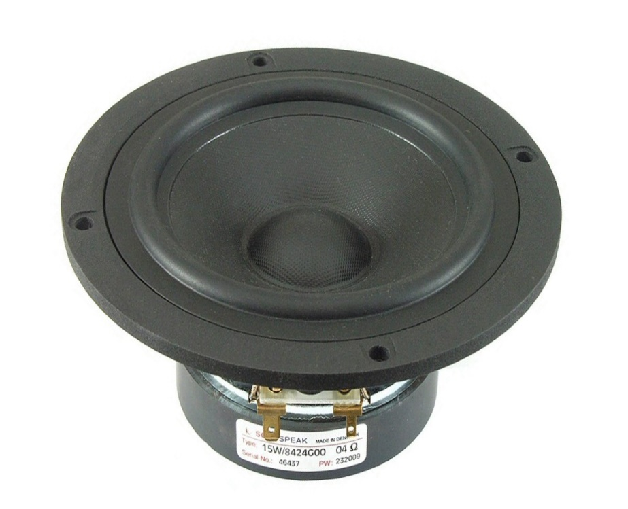
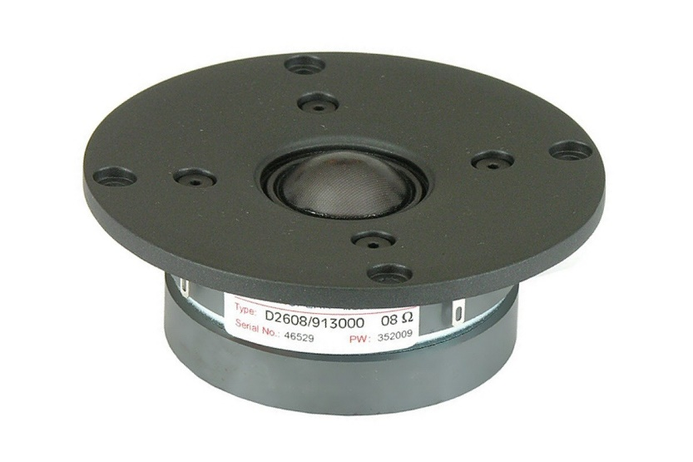
Driver Choice
A designer usually looks for drivers that work well together to give you the smoothest integrated frequency response.
Manufacturers Spec sheets help the designer to choose their drivers. But we have to remember that a large driver whilst usually producing more bass, also usually needs a larger cabinet. There is always a give and take when designing a speaker.

Slide 4
Things to consider when choosing drivers
What application do I want to use my drivers.
What enclosure size do I want.
How many “ways” is your speaker design.
Budget.
Frequency range of drivers.
Sensitivity matching of drivers.
Looks.

Slide 5
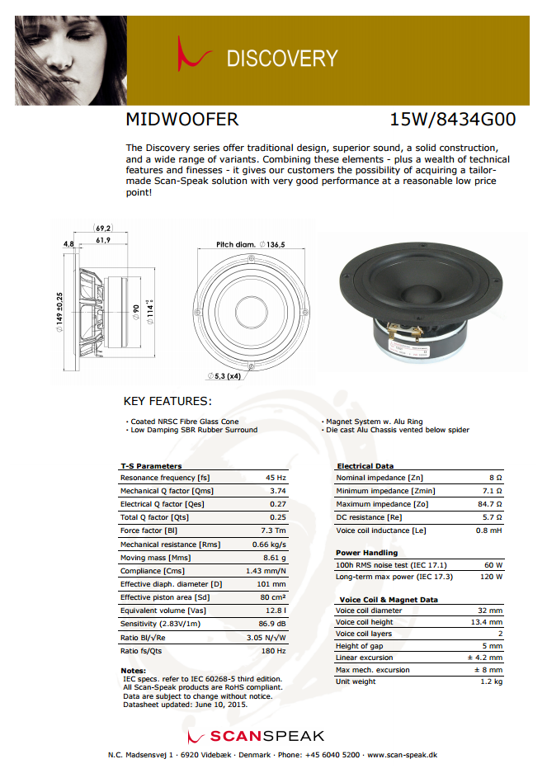
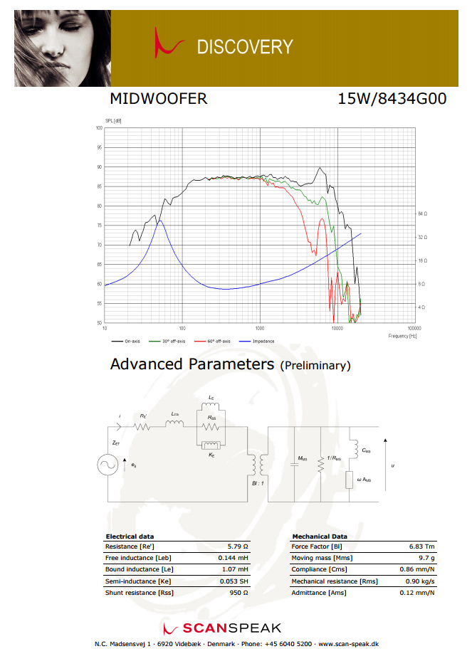

Slide 6
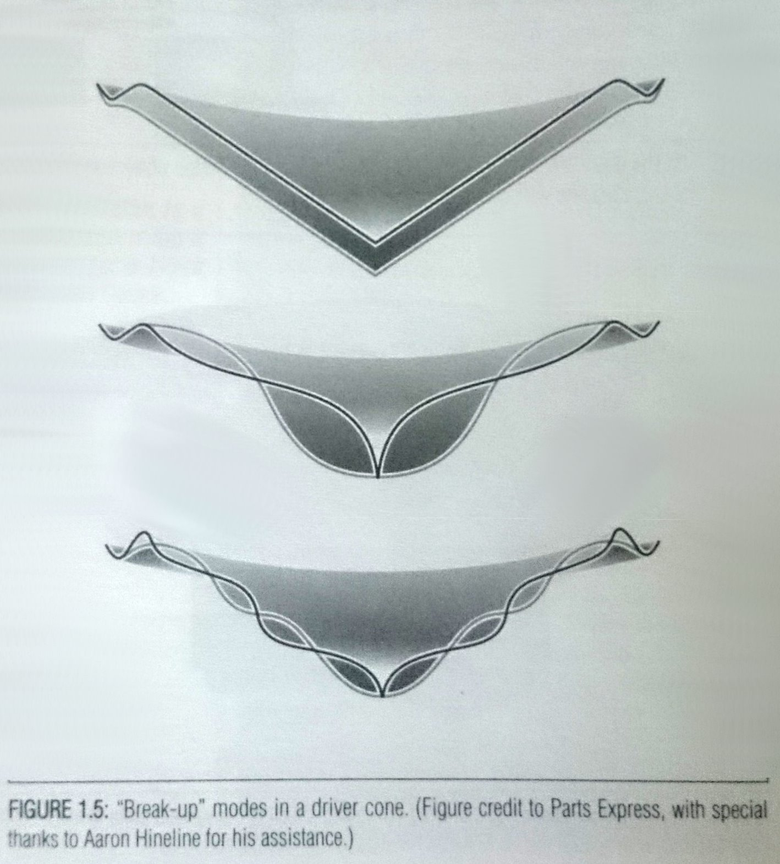

Slide 7
Big 3 Woofer Parameters
Fs : The frequency the driver resonates in free air. (Hz)
Qts : A number indicating the magnitude of resonance at driver Fs. Smaller numbers indicate that the suspension system and electrical damping have more control on a driver, producing a smaller amplitude at resonance. Qts is a combination of Qes(electrical Q) and Qms(mechanical Q).
Vas : The volume of air having a compliance equivalent to that of the drivers suspension system. The word compliance used here is the opposite of the word stiffness; larger implies ease of motion.

Slide 8
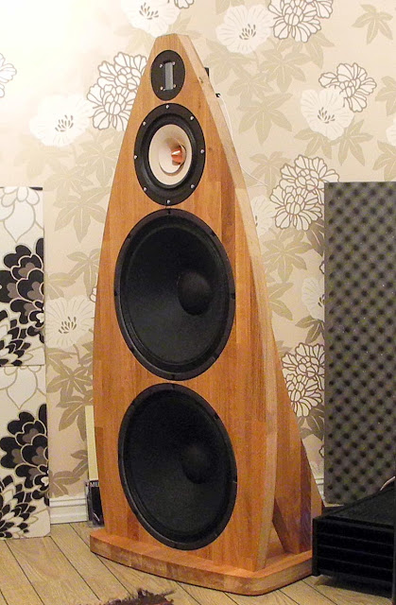
Enclosure Types
Open Baffle/ Infinite baffle: Mounting of a driver on a panel. Sometimes called Infinite Baffle. Since panels aren’t infinitely large the closest we can get is mounting drivers on a wall with the rear space made as another room.

Slide 9
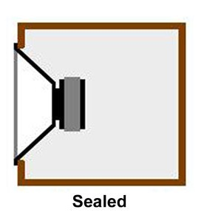
Closed Box
Closed Box / Infinite Baffle: Mounting a driver on a completely sealed box thus separating the drivers front and rear acoustic energy. This prevents cancellation of bass frequencies as a result and also acts as a filter in the bass region. In early days a closed box was sometimes referred to as infinite baffle. A closed box has a 12db/octave roll off.
Great Transient response.
Lesser Frequency response.
Less efficient (only using front wave).

Slide 10
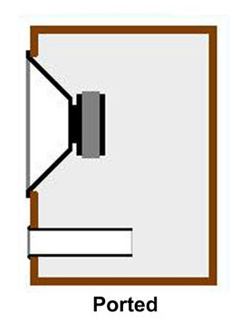
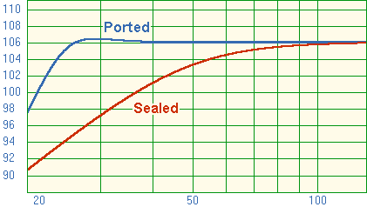
Bass Reflex / Vented / Ported
Using a vented box one can make a speaker that goes 1/3 of an octave lower than the cut off frequency of a closed box. Or you can keep the same f3 of the closed box but achieve it at a smaller box volume. A ported box has a rolloff of 24db/octave (below port frequency).
Less transient response.
Greater frequency response.
More efficient (using back wave at low frequencies).

Slide 11
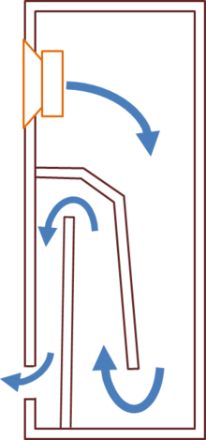
Transmission Line
Good transient and frequency response.
Efficient use of back wave.

Slide 12
Suitability of drivers in enclosures
A general formula EBP(efficiency bandwidth product) = Fs/Qes
<= 50 = Sealed enclosure suitability. Woofers used in a closed box should have an Xmax>5mm for 10”-12” woofers or an Xmax 2mm-5mm for 6”-8” drivers.
50 -100 = Either ported or sealed.
>100 = Ported enclosure suitability.
This is a guideline only and is mainly for passive crossover designs. Using an active DSP system like miniDSP allows a designer to use equalisation to allow for changes to box sizes, shape etc. (up to a point)

Slide 13
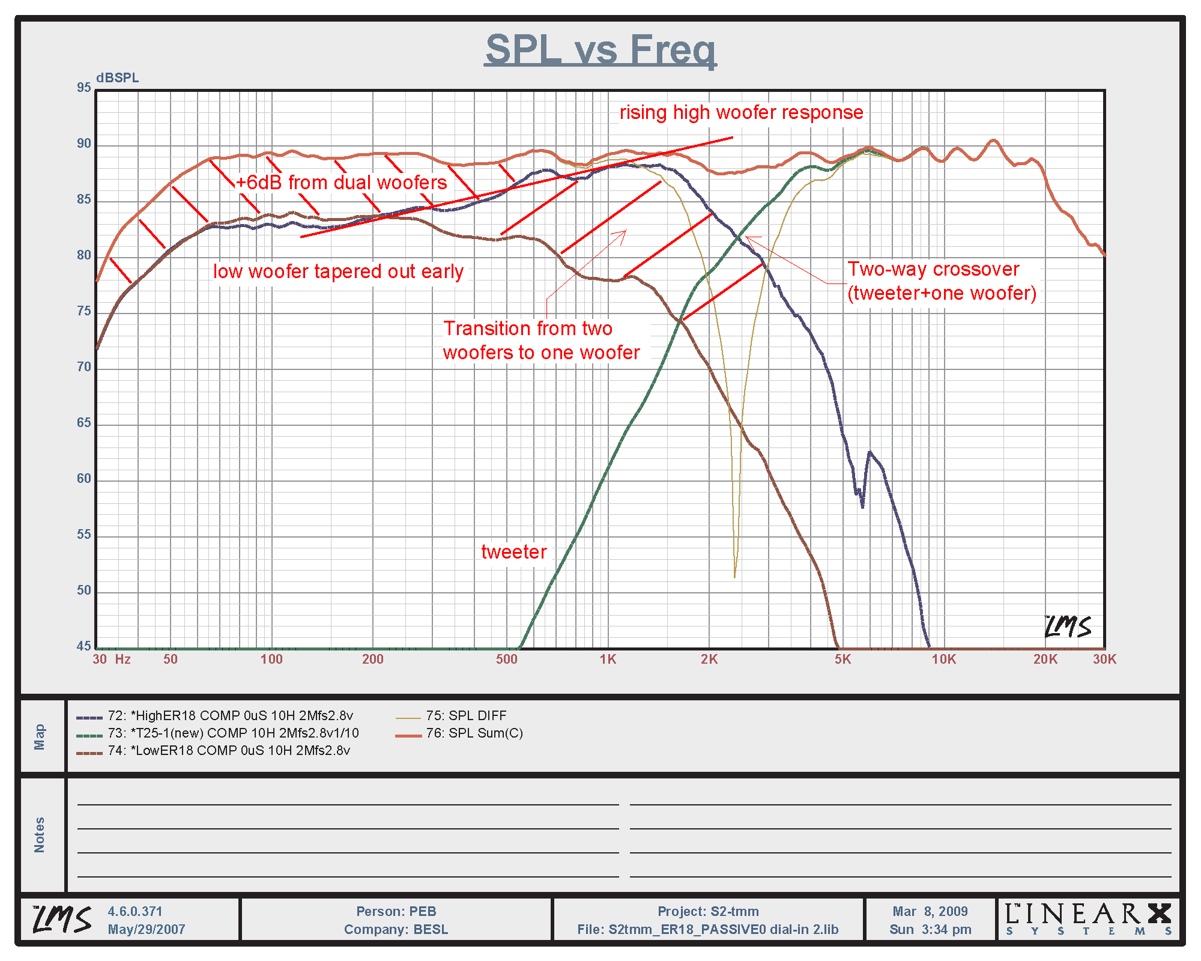
Other considerations
Frequency response curves of two drivers intended to use should overlap each other by at least an octave.
Ideally drivers should have relative comparable sensitivity ratings. Otherwise be prepared to use attenuation resistors in the design. Usually the tweeter needs padding down to match the woofer.

Slide 14
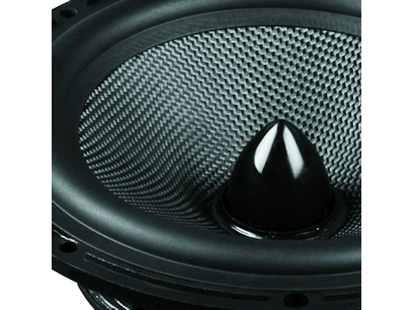
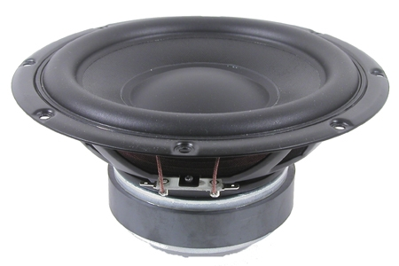
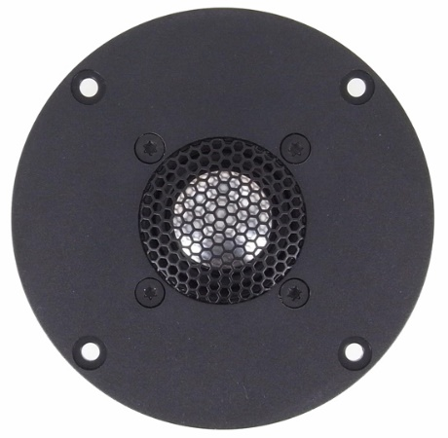
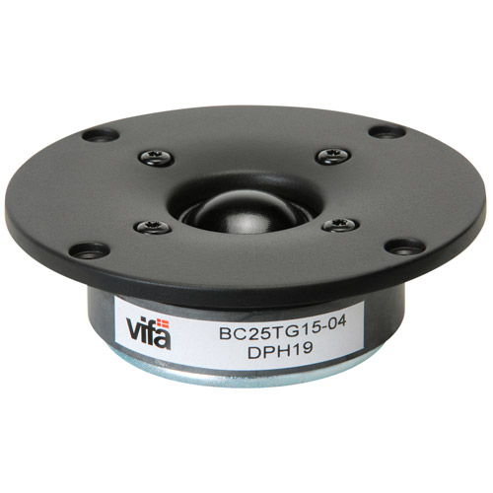
Timbre Quality
Drivers use different textiles in their cones/domes. This also changes the sonic signature of the drivers. Kevlar will not sound the same as a paper or polypropylene cone. The same as you may like the sound of silk or fabric dome tweeters to that of aluminium dome tweeters. Take notice of speakers you have listened to and liked and you will find a preference for certain driver constructions.

Slide 15
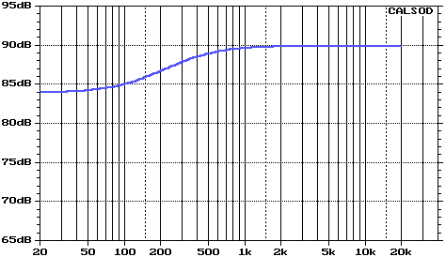
Baffle Step
A speaker mounted onto a baffle exhibits what is known as baffle step(apart from true infinite baffle). That is, a decrease of usually around 6Db at a given frequency (given by the width and shape of the baffle the driver is mounted on). In the example above the factory specified efficiency of the driver would be 90dB per watt.

Slide 16
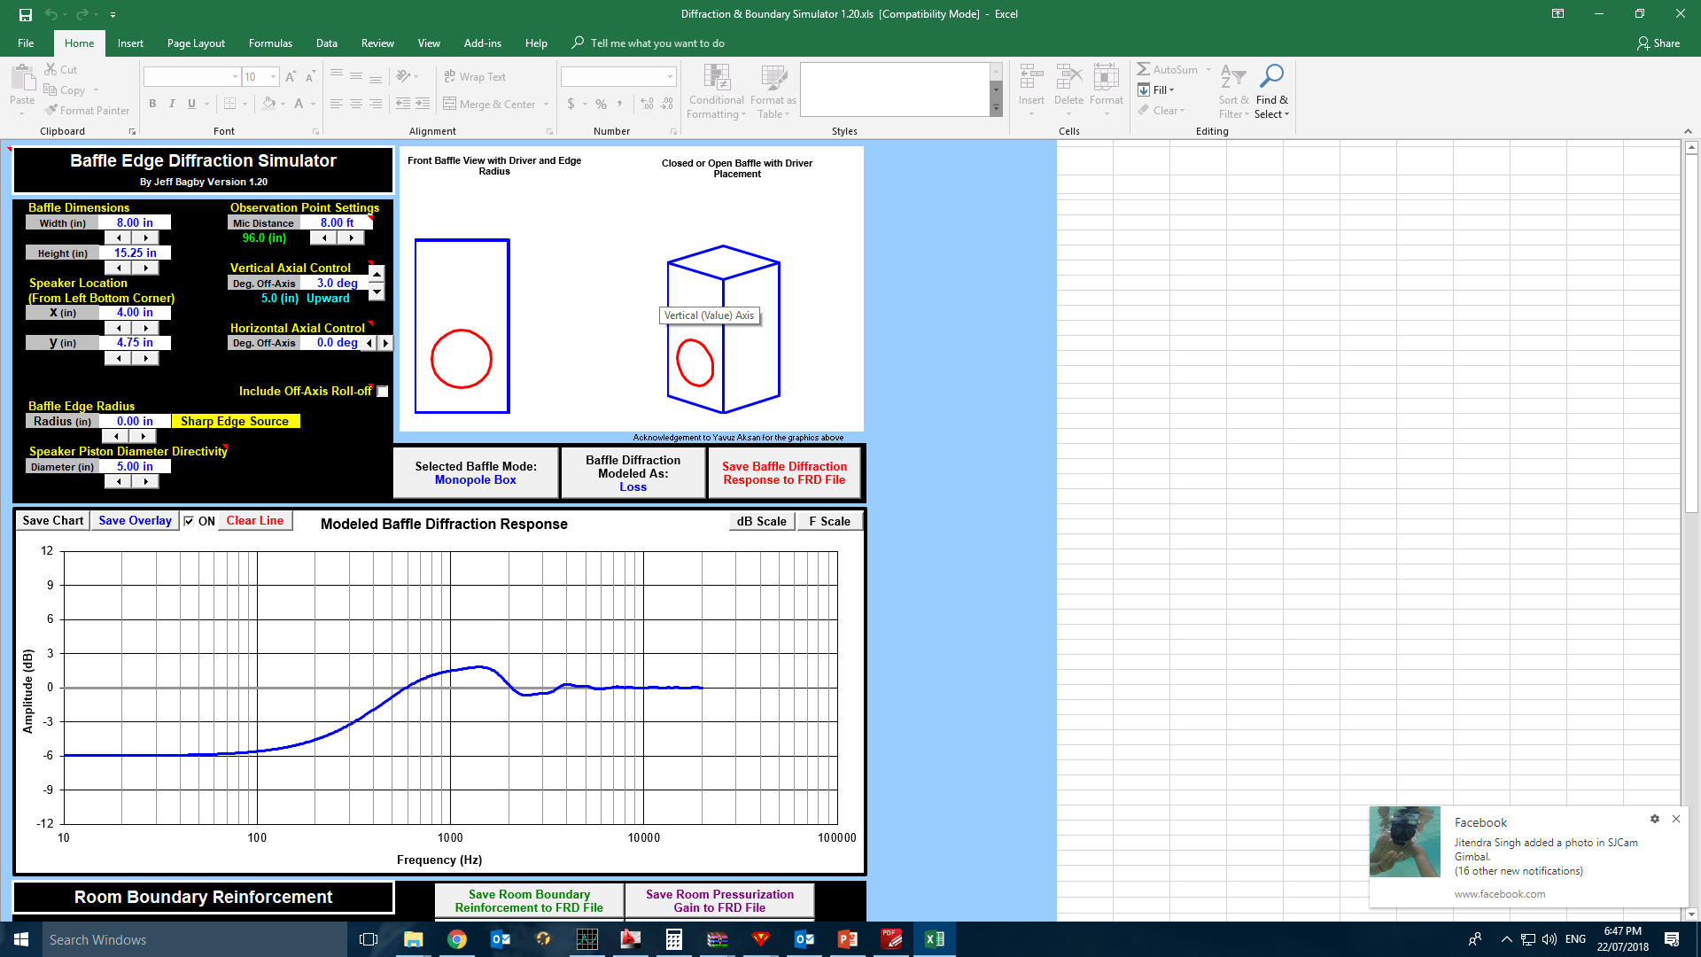
Baffle Diffraction Simulators
Jeff Bagby’s – The edge Diffraction simulator
http://audio.claub.net/software/jbabgy/jbagby.html

Slide 17
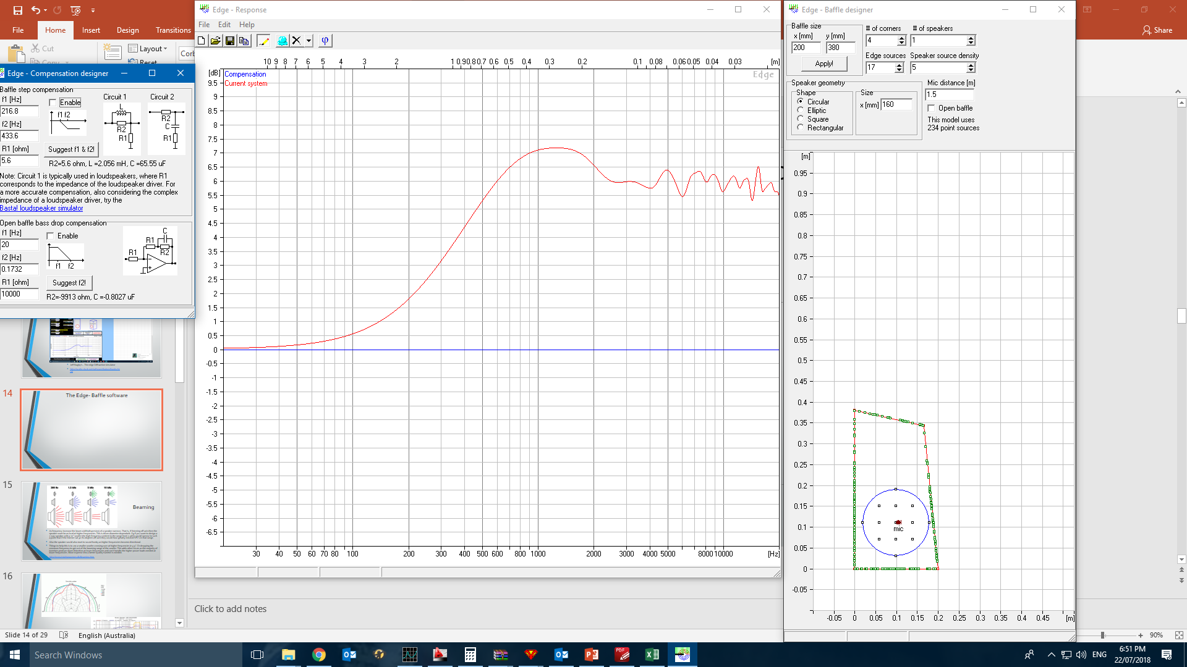
The Edge- Baffle software
http://www.tolvan.com/edge/help.htm

Slide 18
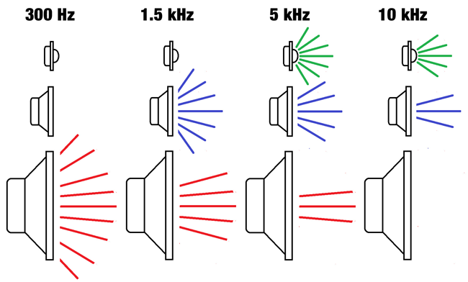
Beaming
As frequency increase the beam width(dispersion) of a speaker narrows. That is, if listening off axis then the speaker wont be as loud at higher frequencies. This is driver diameter dependant. Eg if you want to design a 2 way speaker with a 10” woofer the high frequency content in the range from 1-3kHz would narrow to such a point that if the listener sat 30-60 degrees off axis they would hear greatly reduced SPL’s in that range.
Also the speaker would also start to sound honky as higher frequencies become directional.
Things to help this is to use a smaller woofer crossing over at higher frequencies ie 3-5”. Or dropping the crossover frequency to get out of the beaming range of the woofer. This adds other issues as the majority of tweeters produce more distortion at lower frequencies and can’t handle the higher power loads needed at lower frequencies. More expense into a better quality tweeter is needed. http://www.troelsgravesen.dk/Beaming.htm

Slide 19
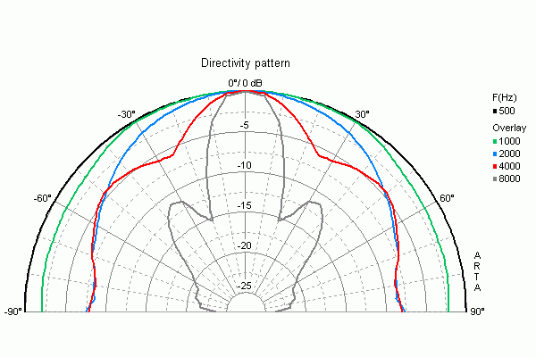
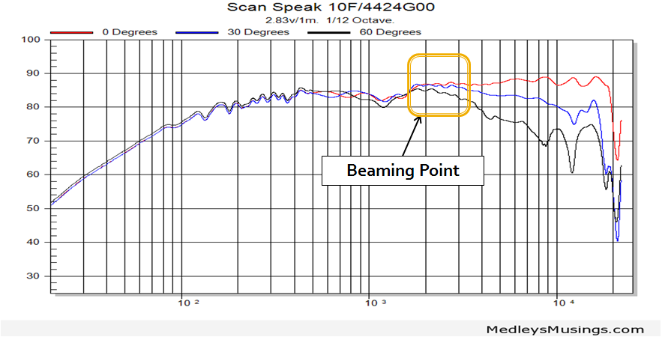

Slide 20
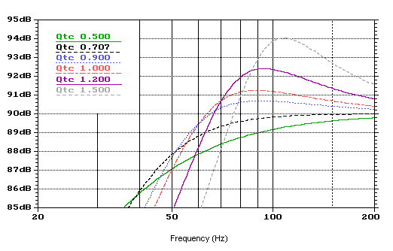
Thiele Small Parameters
Video: Thiele parameters part 1
What are thiele small parameters
Video: Thiele parameters part 2

Slide 21
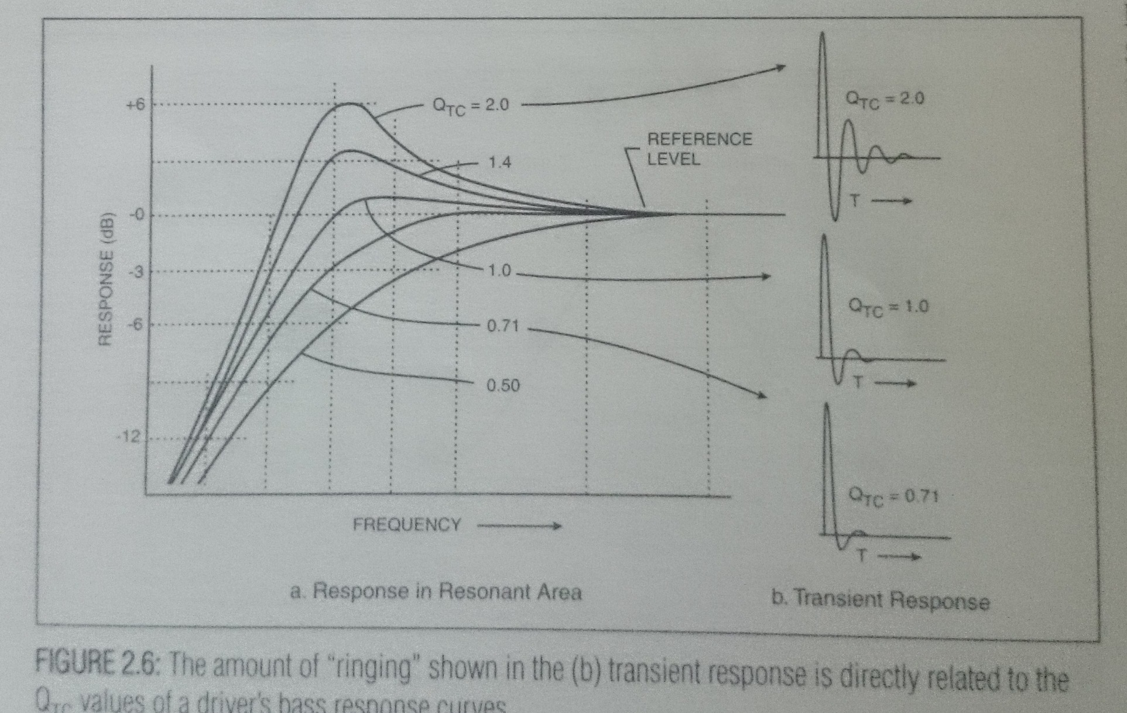

Slide 22
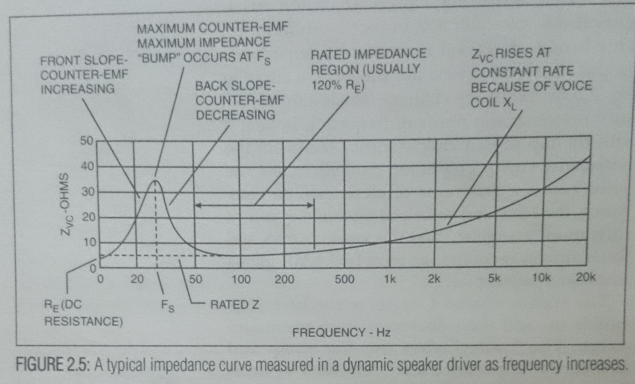

Slide 23
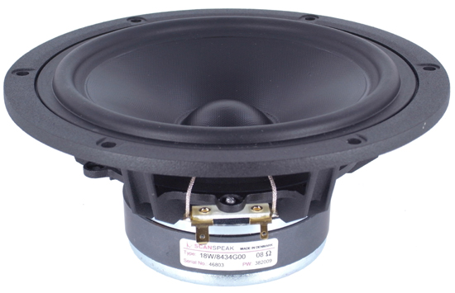
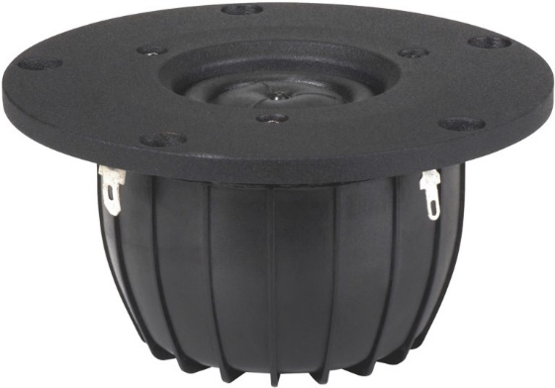
A practical example
We have chosen a bookshelf 2 way speaker system. Using a vented enclosure to get some extra bass out of the 6” woofer.
Woofer Scanspeak 18w/8434 Spec sheet
Tweeter Dayton Esoteric ES25nd-4 Spec sheet

Slide 24
Run in drivers before measurements
It is important to burn in (mechanically soften) drivers before taking measurements. Specs and sound will change during this time.
Tweeters will sound more shrill and bass drivers will produce less bass when brand new.
Can use music, or frequency files for this purpose. If using low frequencies or music on a tweeter, Please put a capacitor 4.7-8.2uf in series with the tweeter to protect it from bass frequencies.

Slide 25
Quasi Anechoic. What?
https://www.soundandvision.com/content/speaker-measurements-101-page-3

Slide 26
Measuring the Drivers
Loudspeaker Measurements Explained
https://www.youtube.com/watch?v=j77VKw9Kx6U
Speaker masurements 101- https://www.soundandvision.com/content/speaker-measurements-101

Slide 28
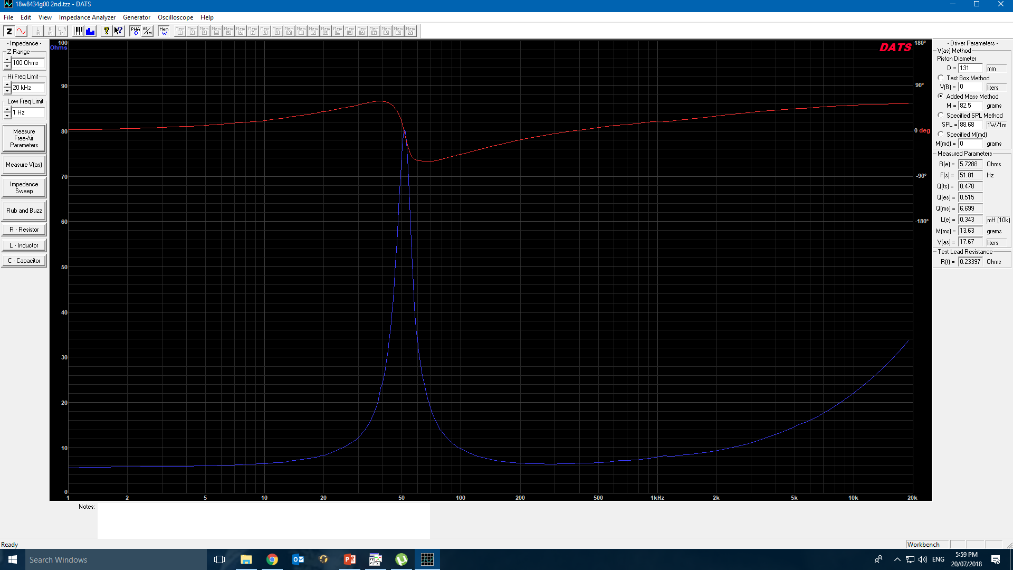
Measure Thiele small parameters
I use “DATS” measurement system
https://www.youtube.com/watch?v=dARRX-tZpg4

Slide 29
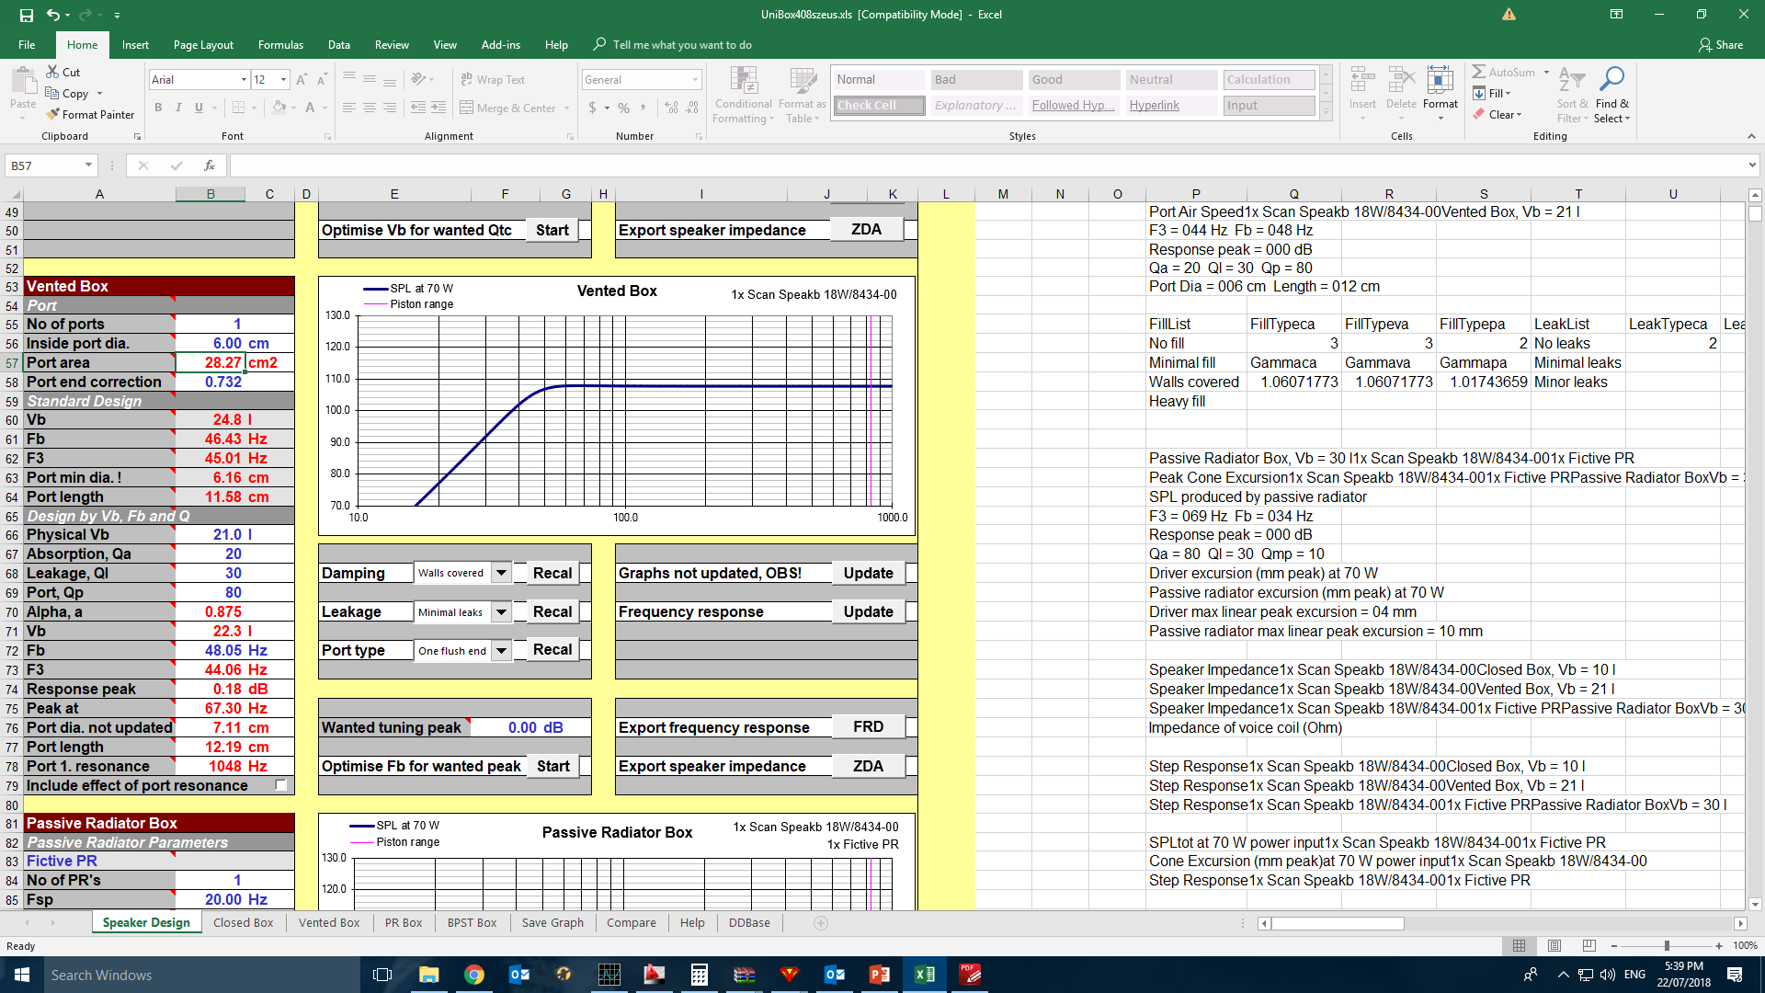
Simulate Box Using woofer parameters
Unibox – Free program

Slide 30
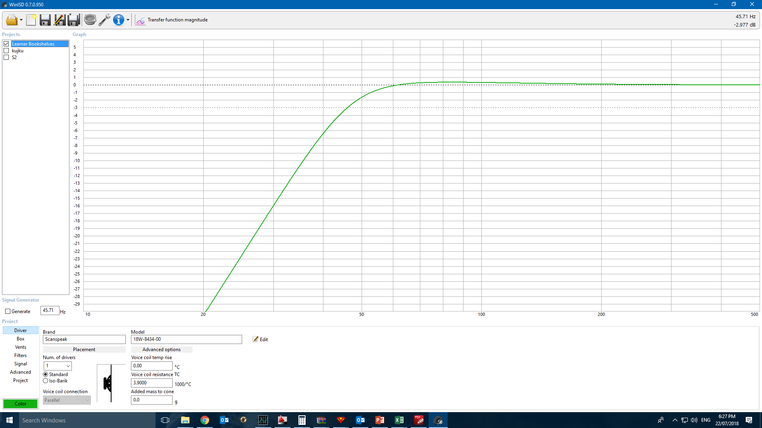
Other Box Modelling software
Winisd – Free!

Slide 31
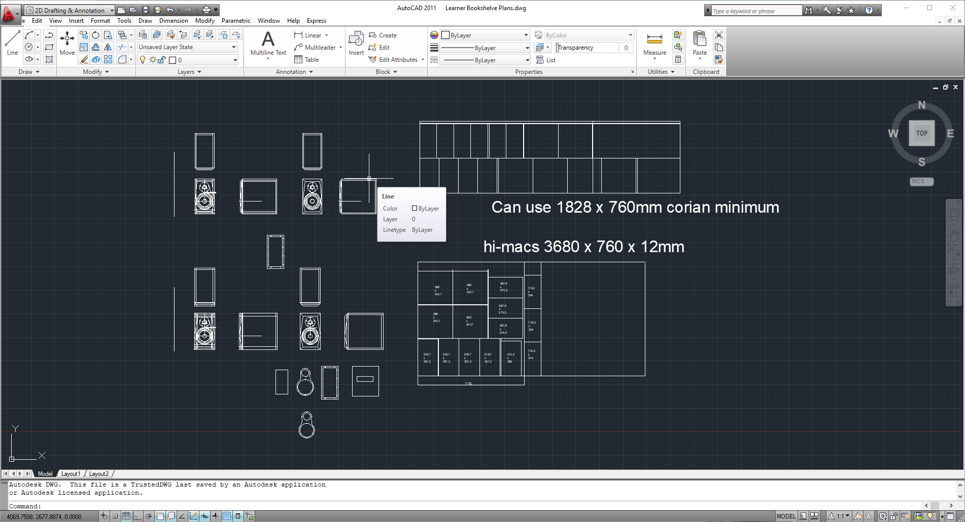
Building the Enclosure
Building your enclosure is designer dependent. The Volume of the woofer or mids is dependant on the driver parameters shown earlier but the visual design and engineering involved is all up to the builder.

Slide 32
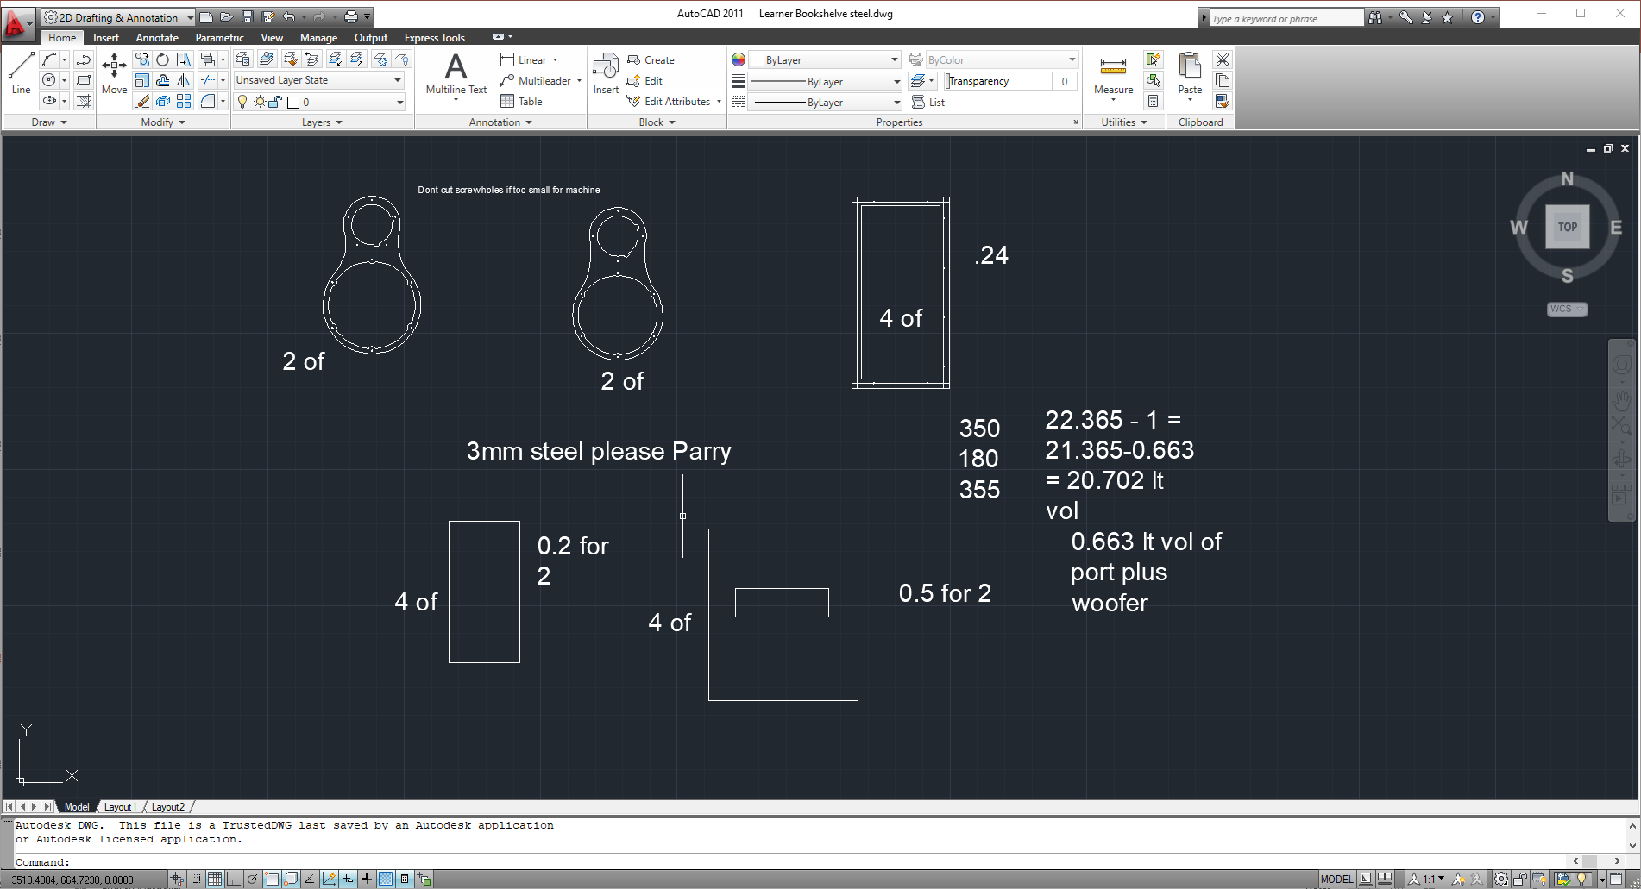

Slide 33
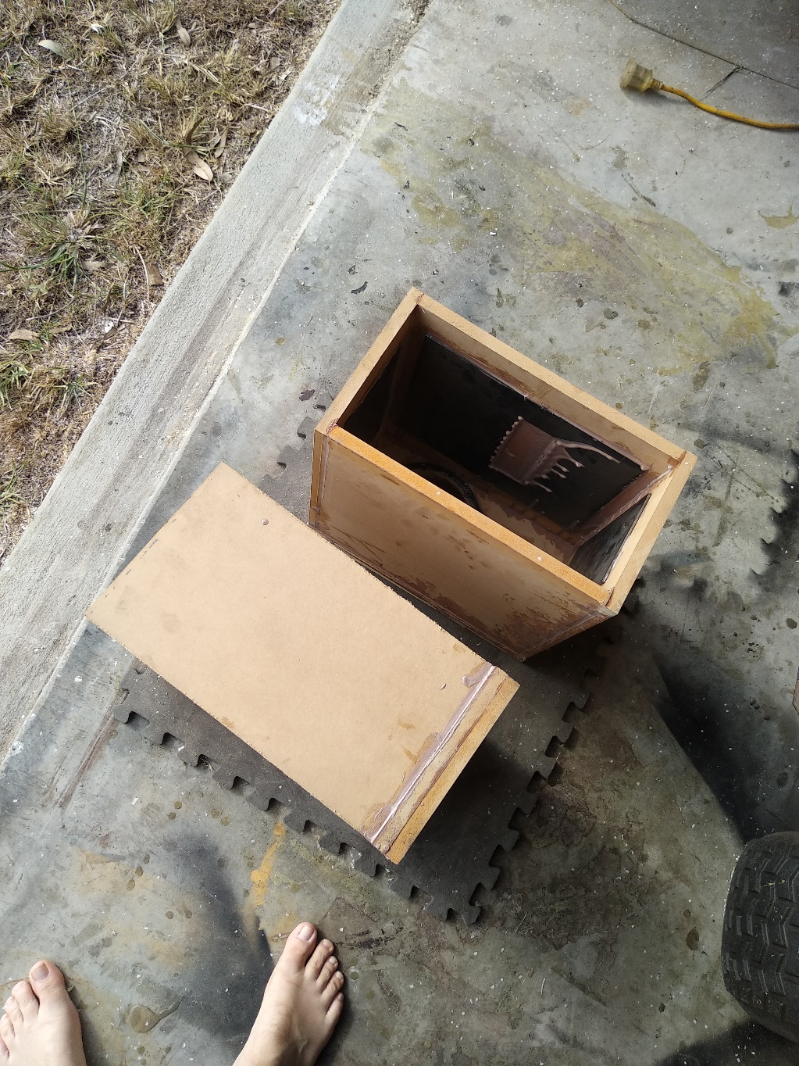
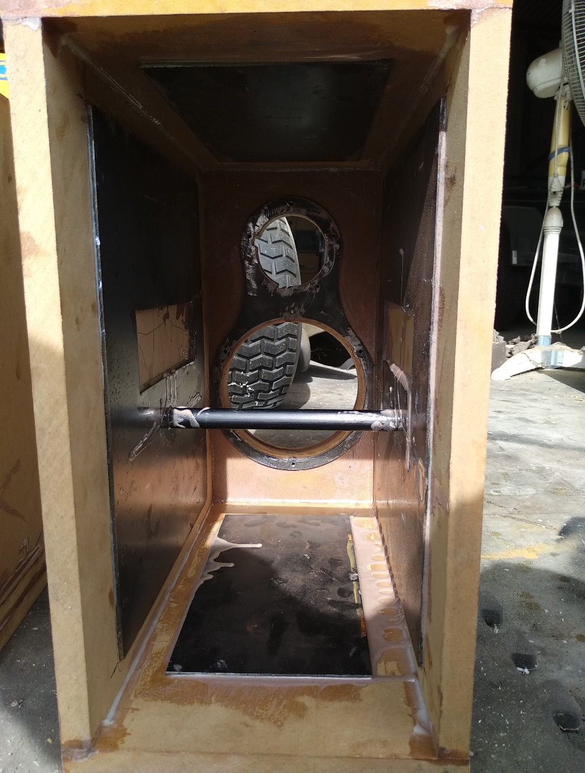

Slide 34
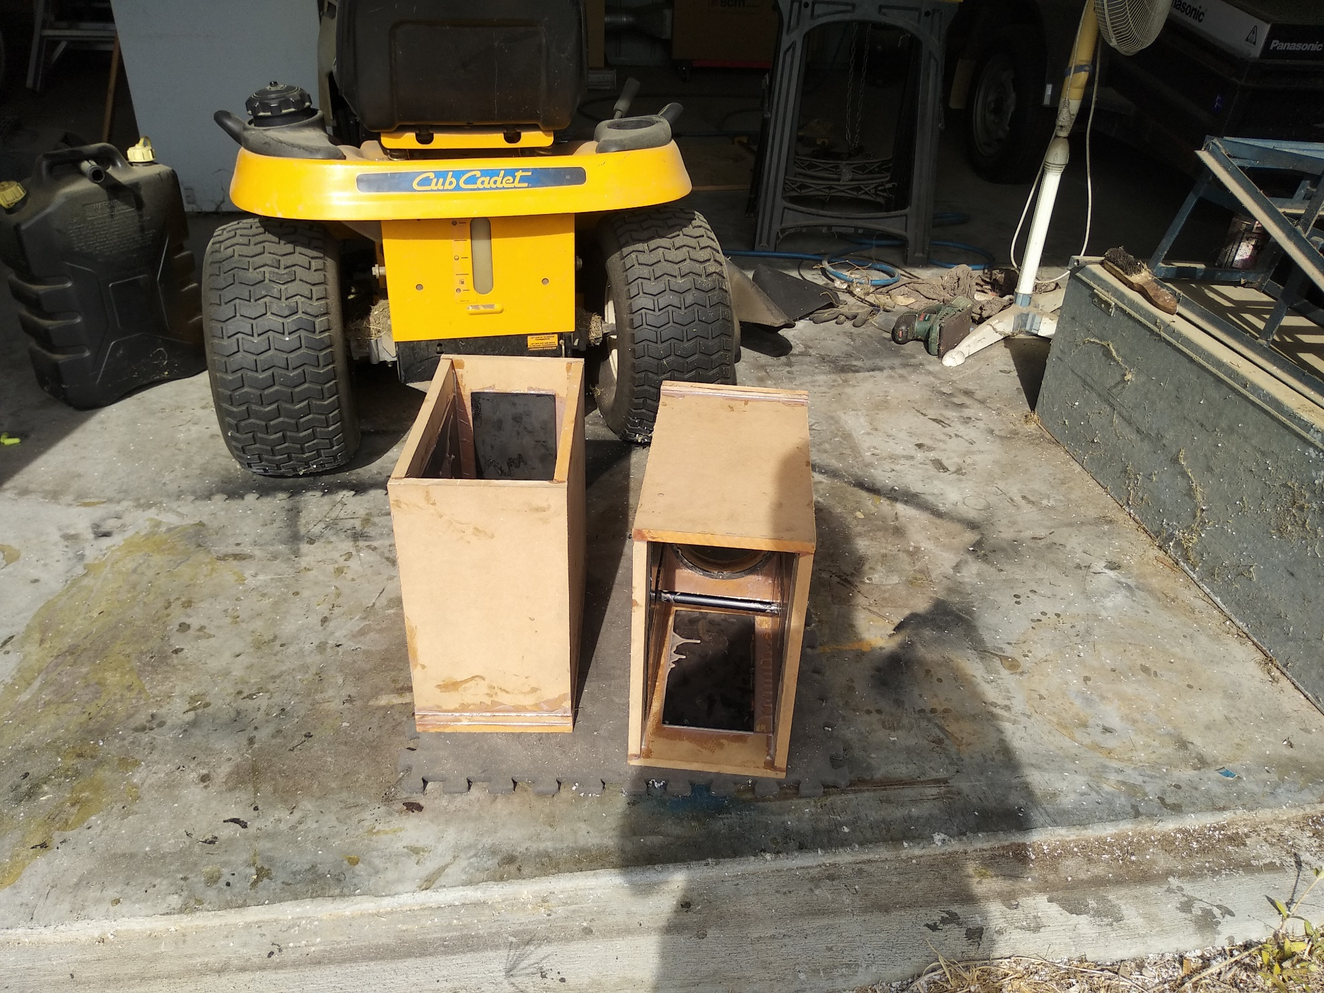

Slide 35
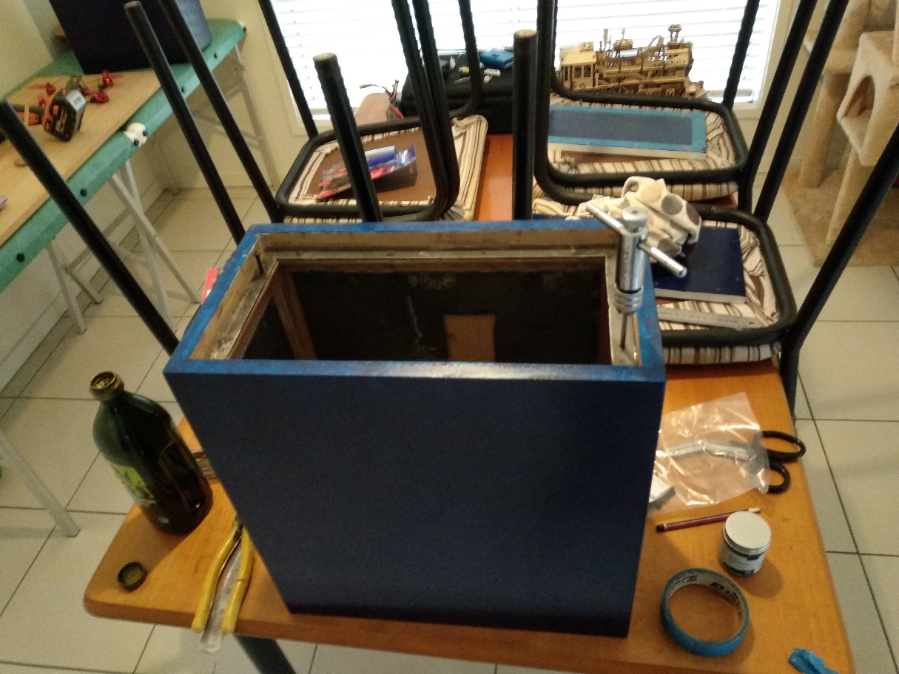
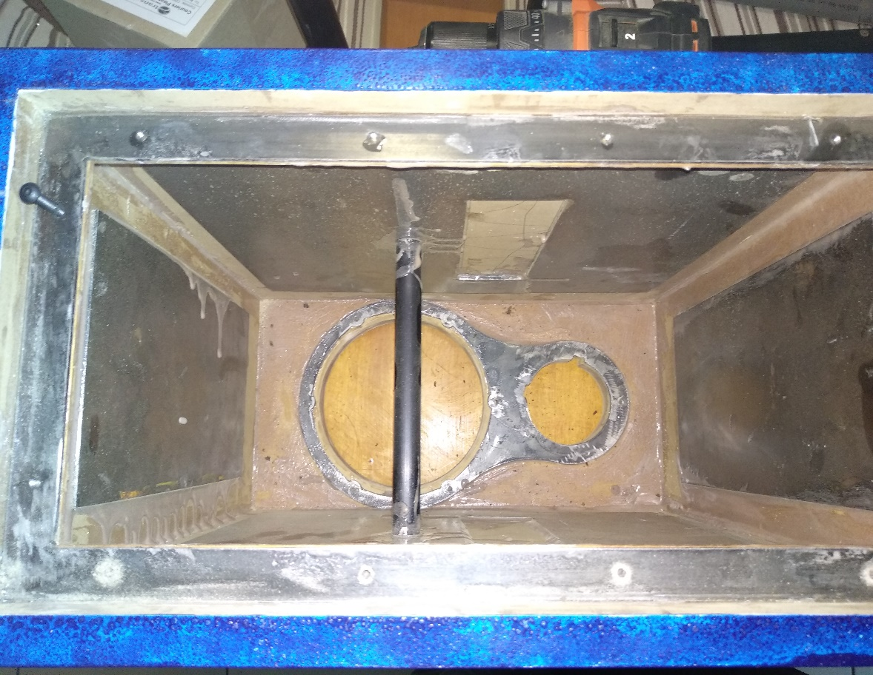

Slide 36
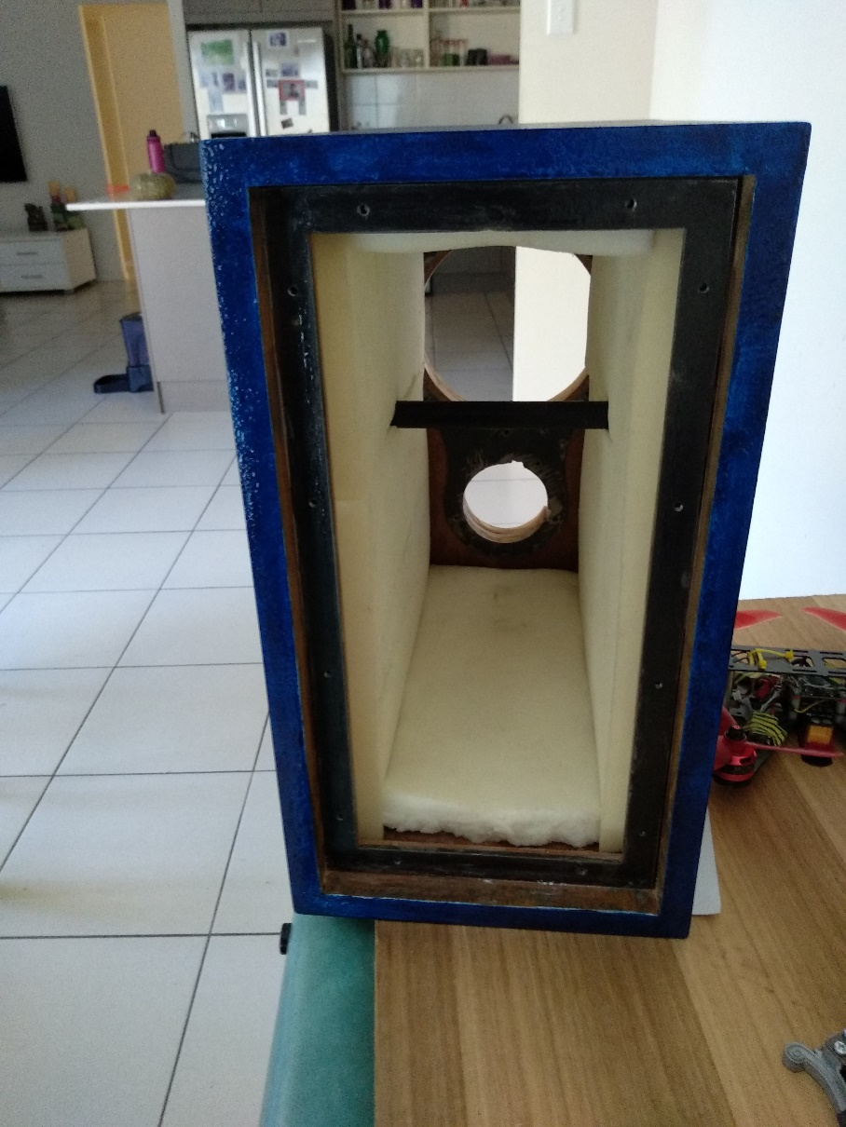
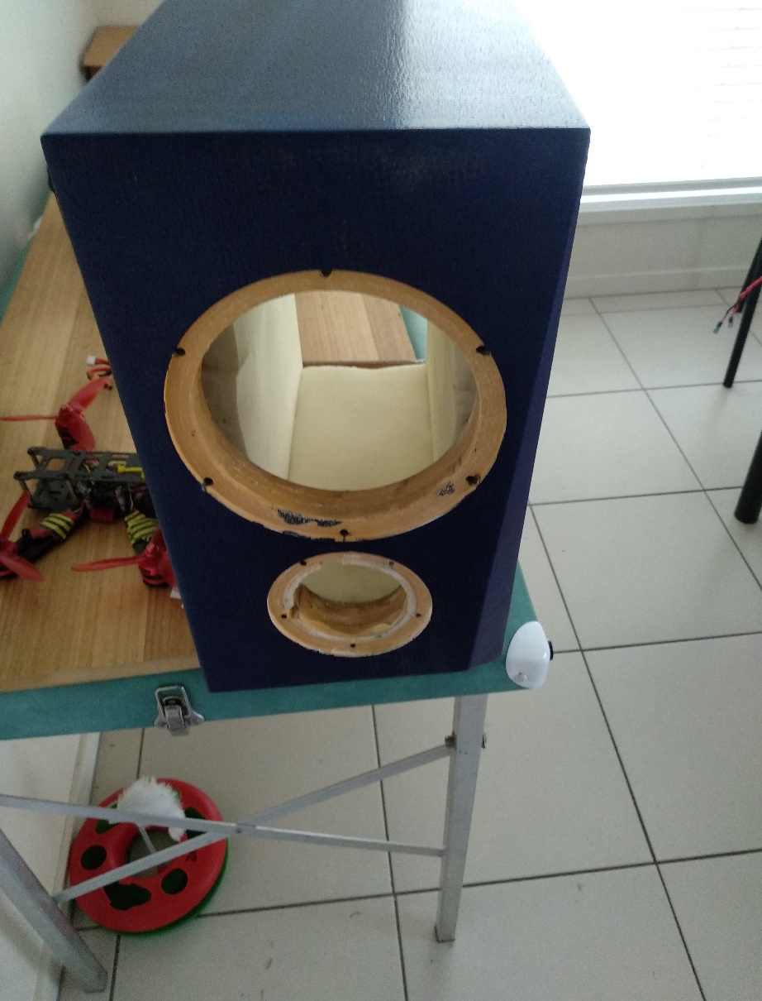

Slide 37
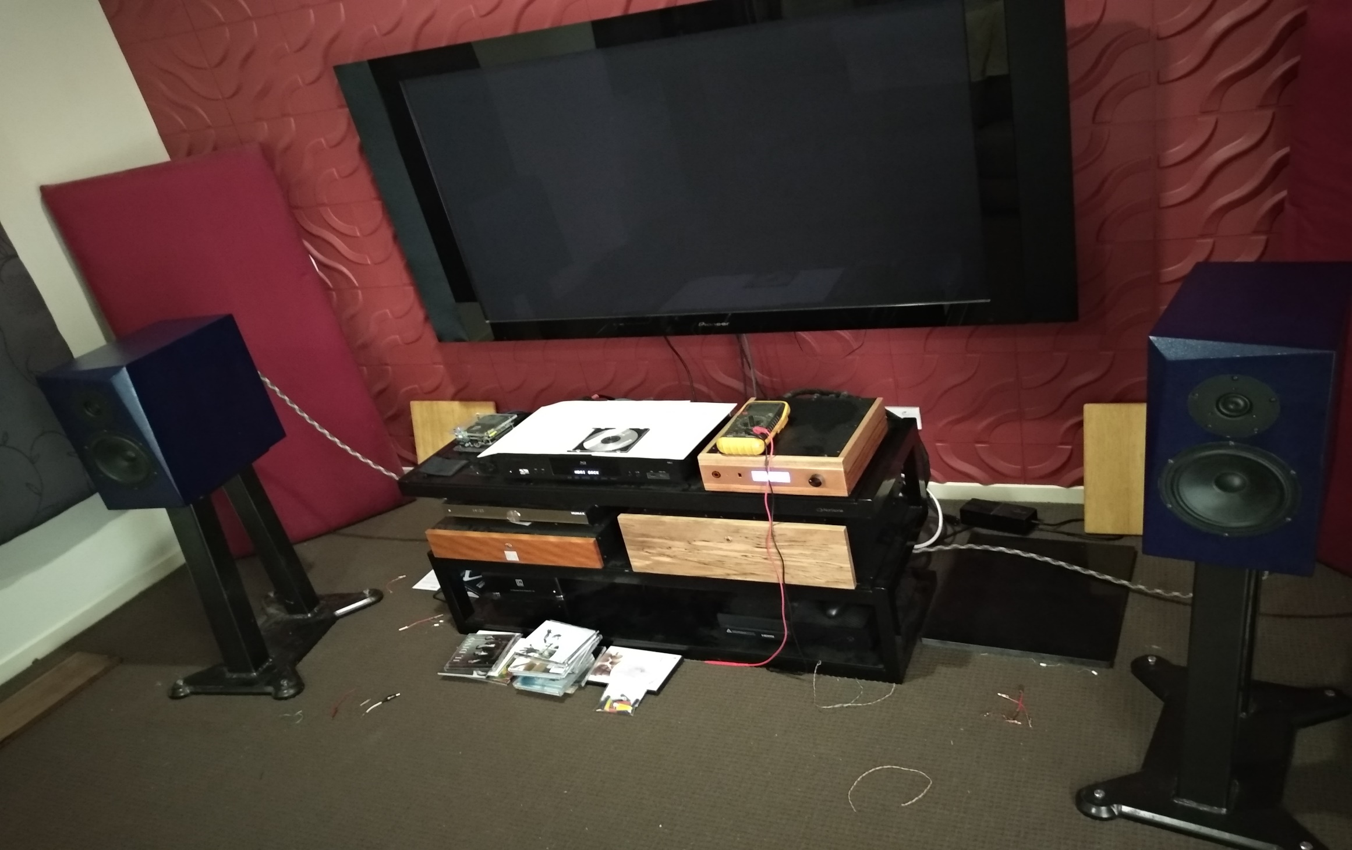

Slide 38
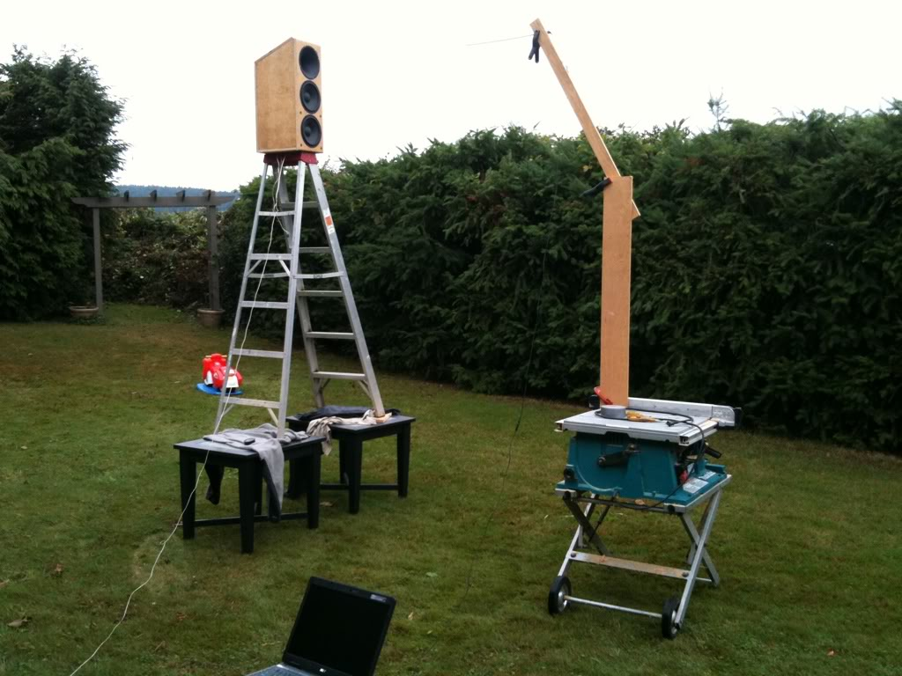
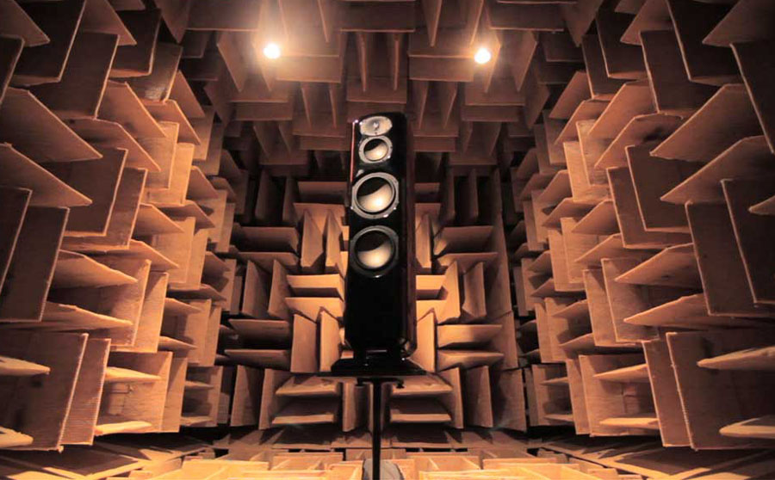
Driver Frequency Graph Measurements

Slide 39
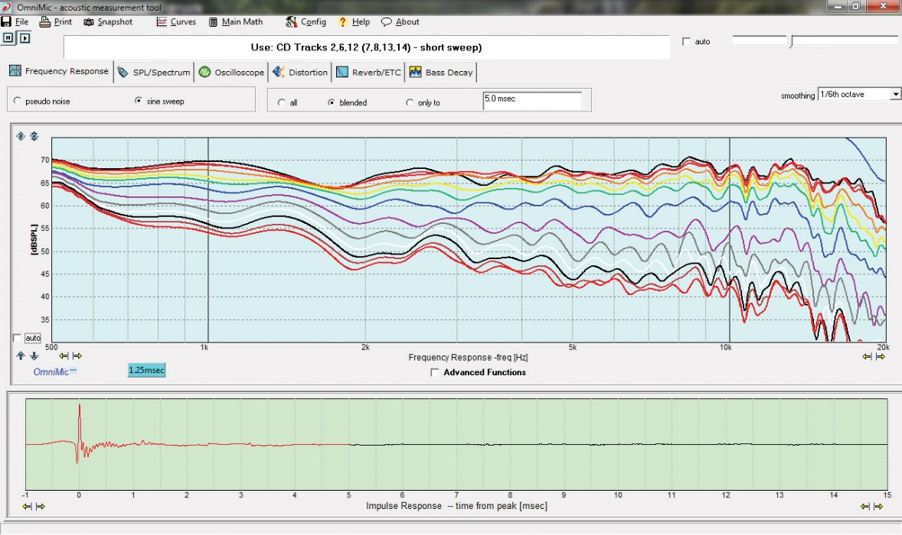
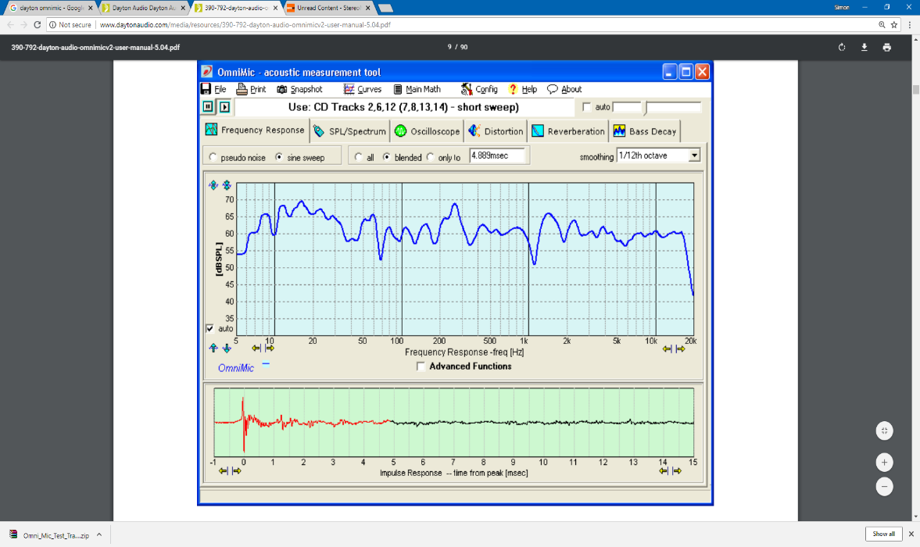
Dayton Omnimic

Slide 40
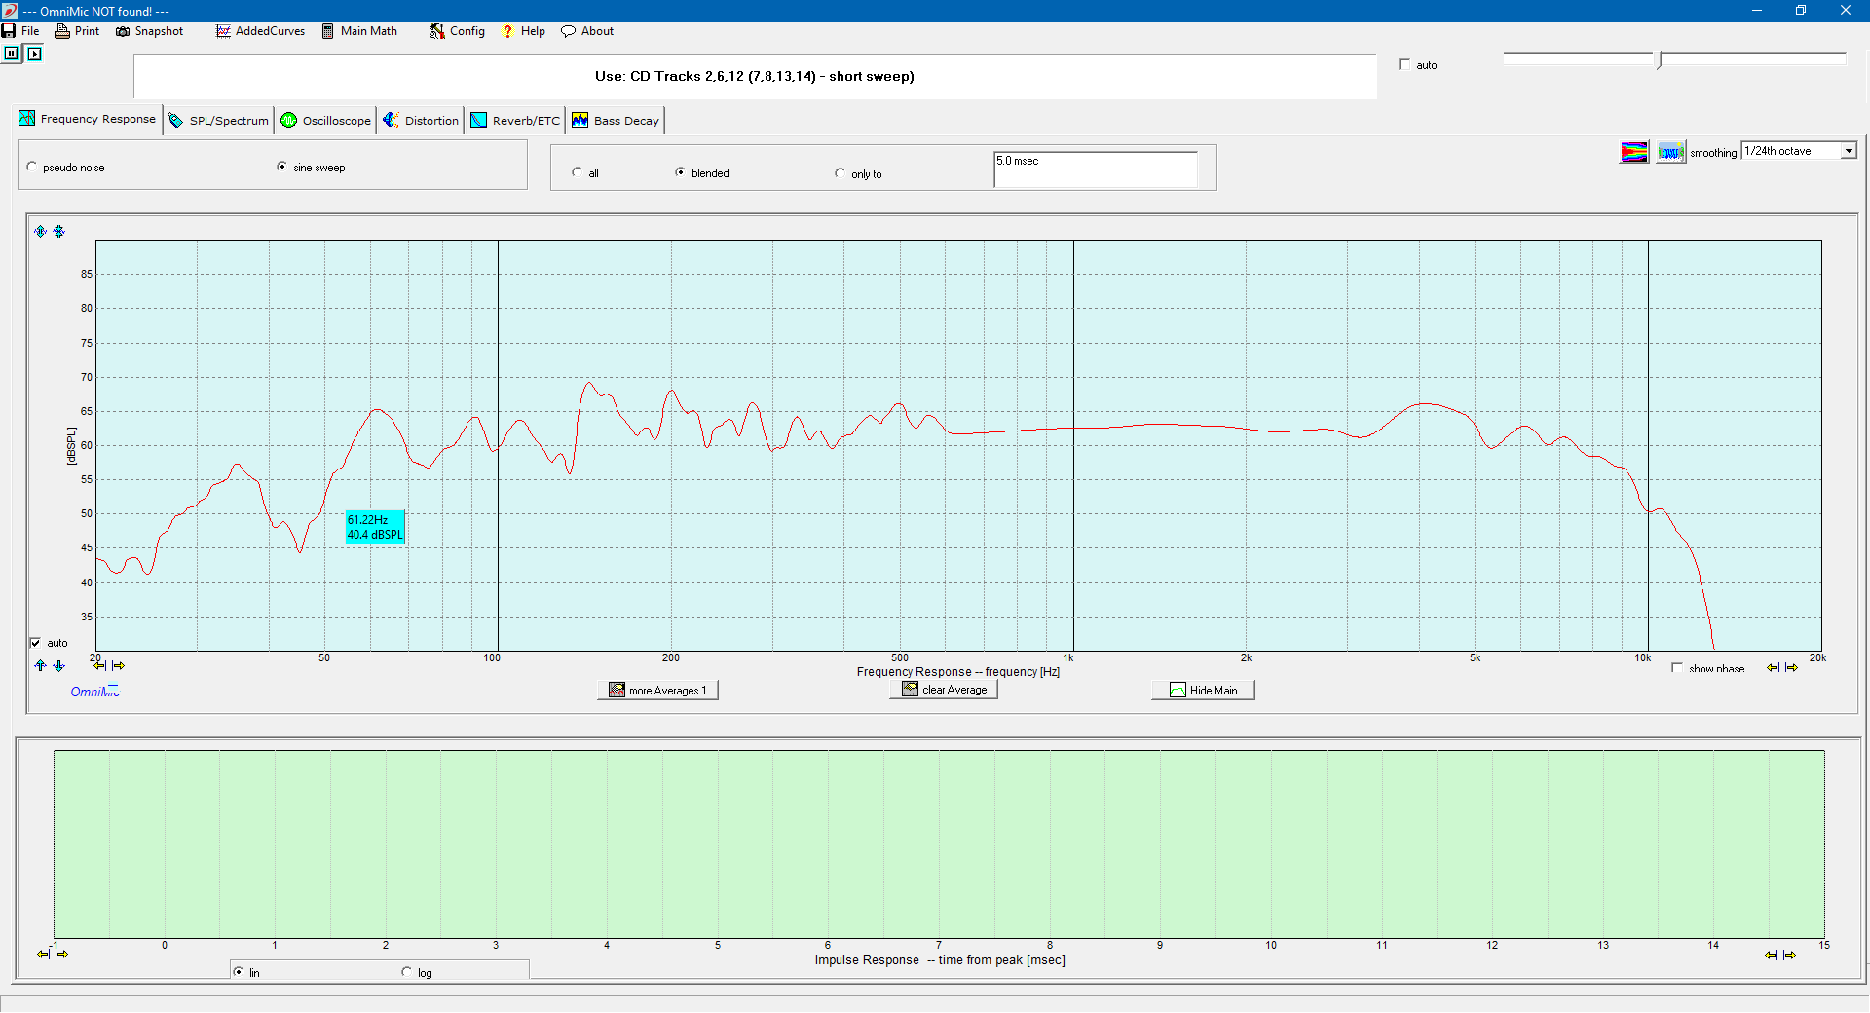

Slide 41
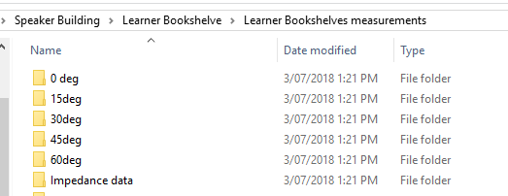
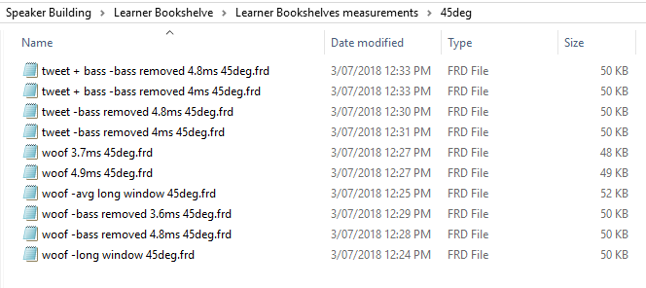
You can never have too many measurements!

Slide 42
Remember to also measure woofer and tweeter together so as to find the Acoustic Offset
So measure tweeter by itself.
Measure woofer by itself.
Measure woofer + tweeter together(wired in parallel).
Do this for all angle measurements as well.

Slide 43
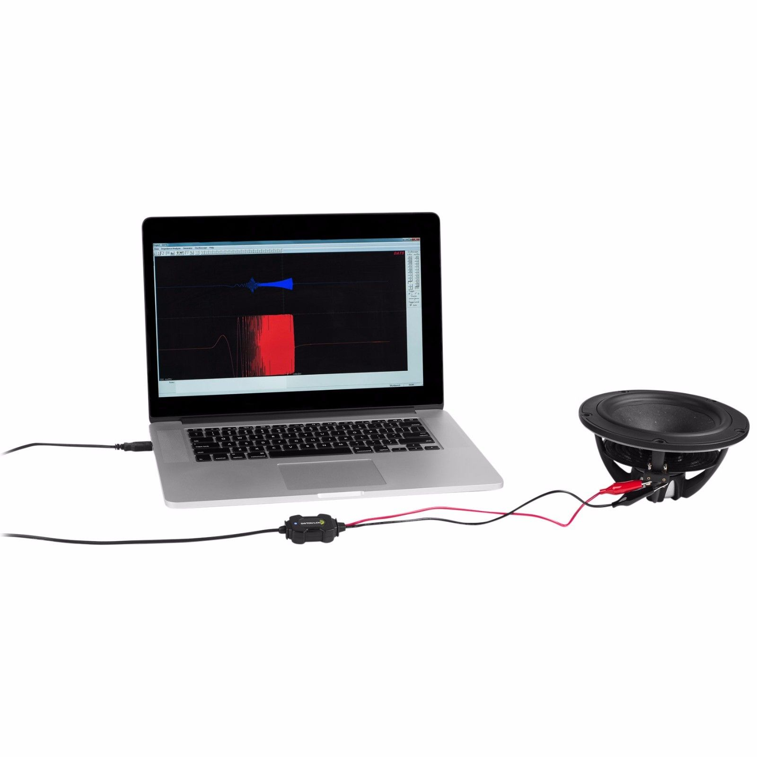
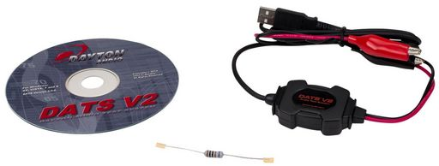
Using DAT’s Software again for Impedance

Slide 44
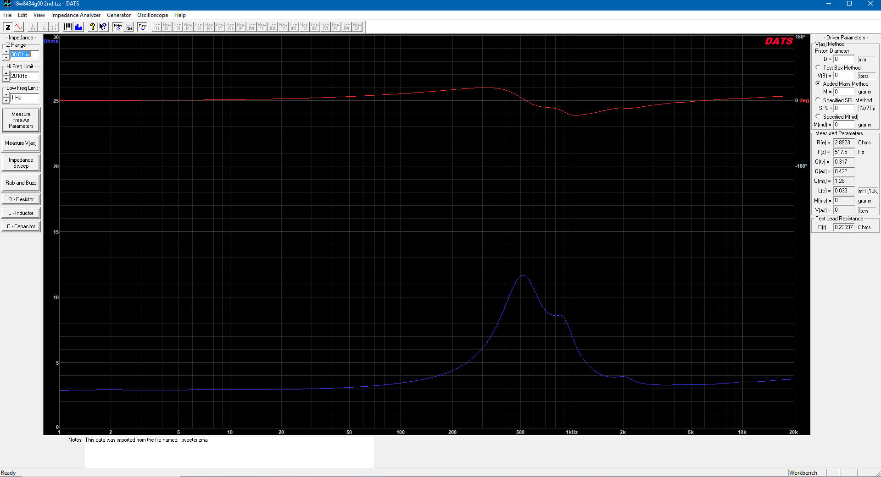
Now we get the impedance measurements of our drivers (as measured in the box).
Tweeter Impedance (and phase in red)

Slide 45
Woofer impedance (Phase in red)
Note the double hump (denoting a ported box being used) with middle saddle the tuning frequency of the box.
We export the impedances and save as a file from the menu structure.

Slide 46
Acoustic offset

Slide 47
Finding acoustic offset

Slide 48
What we want is our combined spl simulated woof + tweeter responses, to equal our measured woofer + tweeter measurement.
This ensures highly accurate data for our simulations to work well.

Slide 49
Now we can start designing our crossover
First we must learn about crossover filters

Slide 54
Final 45deg

Slide 55
Final 0 deg measurements

Slide 57
Useful Links
http://www.troelsgravesen.dk/ Diy site
https://speakerbug.com.au/ Crossover / speaker parts
https://www.parts-express.com/ Store
https://www.madisoundspeakerstore.com/ Store
https://www.falconacoustics.co.uk/ UK Store
https://www.diyaudioandvideo.com/
http://audio.claub.net/index.html free software
https://kimmosaunisto.net/Software/Software.html Free crossover software
https://www.diyaudio.com/forums/software-tools/259865-xsim-free-crossover-designer.html Xsim crossover simulator free
https://www.diyaudio.com/ diyaudio forum

Slide 58
The End. Happy Building

